Slide 1

9th Grade
Scheduling
Class of 2022

Slide 2

Agenda
Transition to High School
Graduation Requirements
Keys to Success
Choosing your schedule

Slide 3
Transitioning to
High School
Scheduling with high school counselors
  Right Now!
  Make changes until January 28th
8th grade parent night
  February 15th 4:30-7:30
Freshmen Orientation
  July
Utilizing High School Resources
  Teachers
  Counselors
  Tutors

Slide 4
Core 40 Graduation Requirements

Slide 6
Academic Honors Diplomas
Core 40 Requirements +
2 additional credits in math
  Trig/Pre-Calculus, Trigonometry and Probability and Statistics, Calculus, or AP Statistics
6-8 credits in World Languages
  6 credits of one foreign language or 8 credits of 2 different foreign languages
2 credits in fine Arts
  Band, Choir, Guard, piano (1 credit), 2D Art, Ceramics, Media Arts, or Journalism Publication
Earn a C- or better in all courses
Have a GPA of 3.0 or higher
Complete one of the following:
  6 dual credits
  2 AP class and exams
  SAT or ACT requirement

Slide 7

Freshman Sample Schedule
Monday/Tuesday/Thursday/Friday |  |  | Wednesday
Periods/Times | Course |  | Periods/Times | Course
Period 1 | Algebra 1 |  | Period 1 | Algebra 1
7:30-8:20 |  |  | 7:30-8:20
Period 2 | Spanish 1 |  | Period 2 | Spanish 1
8:25-9:10 |  |  | 8:25-9:10
Period 3 | P. E. |  | Period 3 | P. E.
9:15-10:00 |  |  | 9:15-10:00
Period 4 | Geog/Hist. of the World |  | Period 4 | Geog/Hist. of the World
10:05-10:55 |  |  | 10:05-10:55
Power Hour 1 |  |  | Period 5 (1st Floor) | Lunch: 10:55- 11:25 Class: 11:30 - 12:15
10:55-11:25
Power Hour 2 |  |  | Period 5 (2nd Floor) | Class (Biology): 11:50- 11:45 Lunch: 11:45- 12:15
11:25- 11:55
Period 5 | Biology 1 |  | Period 6 | English 9
12:00- 12:45 |  |  | 12:20-1:05
Period 6 | English 9 |  | Period 7 | Journalism
12:50- 1:35 |  |  | 1:10-2:00
Period 7 | Journalism
1:40- 2:30

Slide 8
Required Courses
Freshmen Year
Math: Algebra 1 or Geometry* or Algebra 2*
English: English 9 or English 9H
Science: Biology or Biology H
Social Studies: Geography/ History of the World
Physical Education: 2 Semesters
Electives: 2 periods

Slide 9
Elective Options
Please consider all your options- you are committed to your choice
What is your future career pathway?
Should I take a foreign language?
  Spanish 1
  French 1
https://www.youtube.com/watch?v=eiG503NtNUs

Slide 10
Choosing your schedule

Slide 11
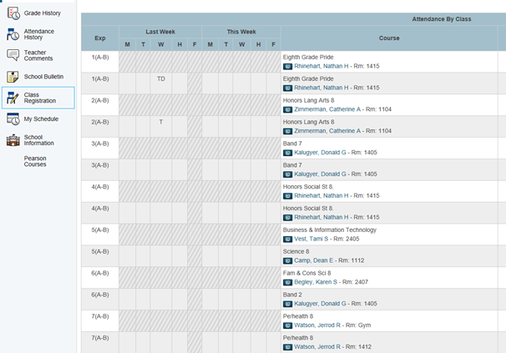

Slide 12
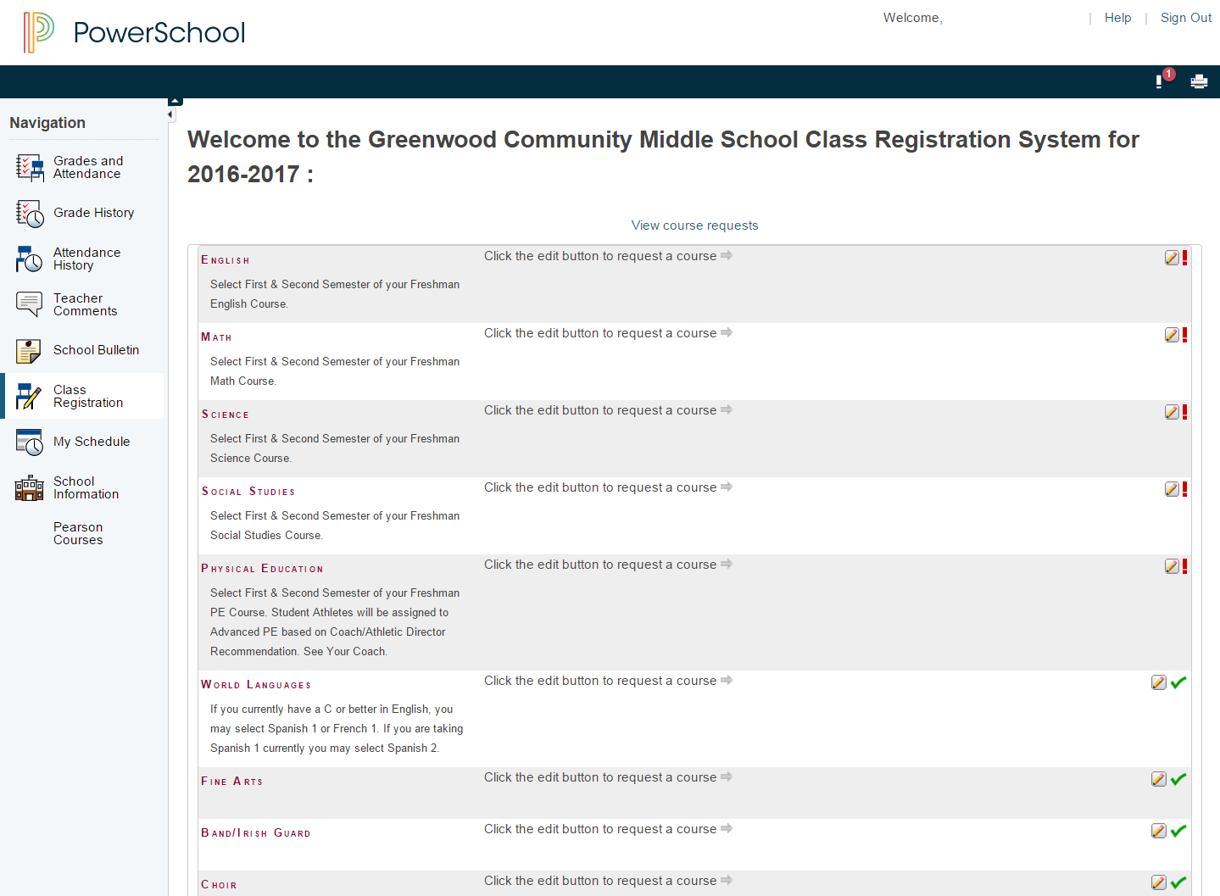

Slide 13
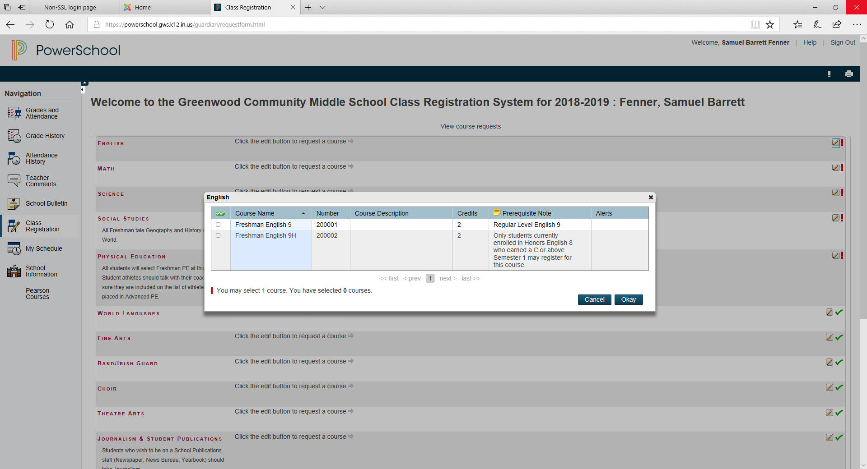

Slide 14
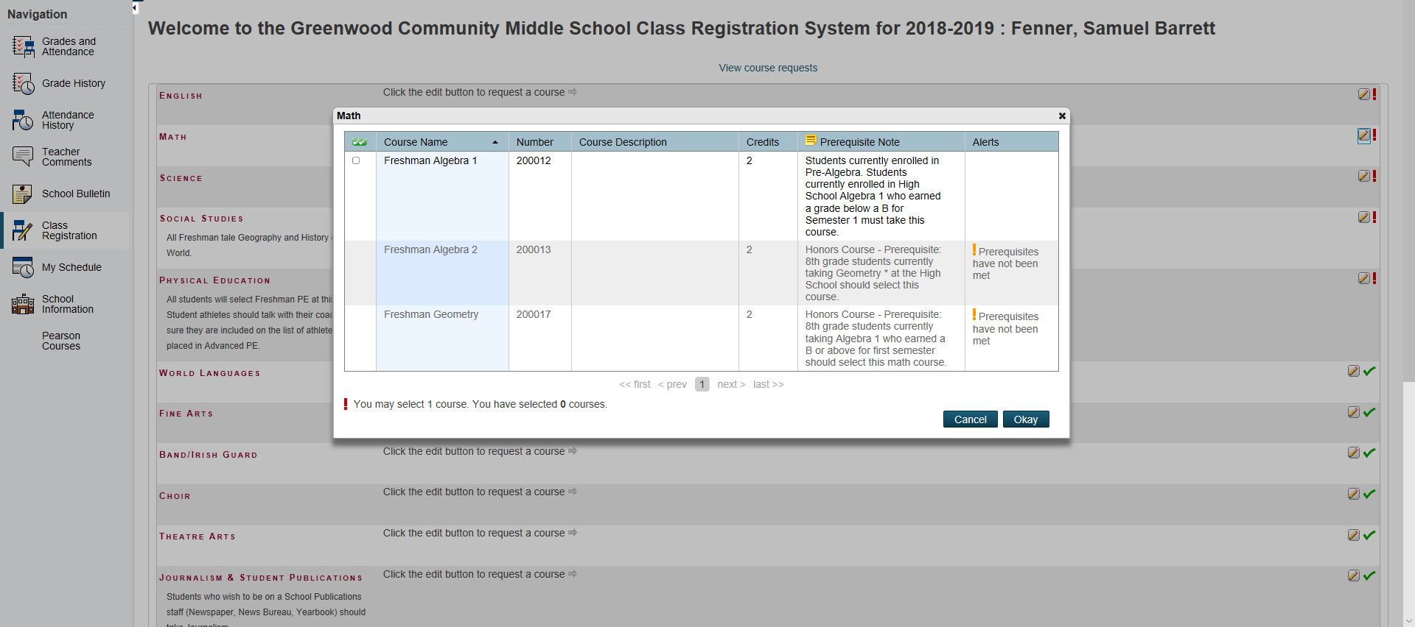

Slide 15
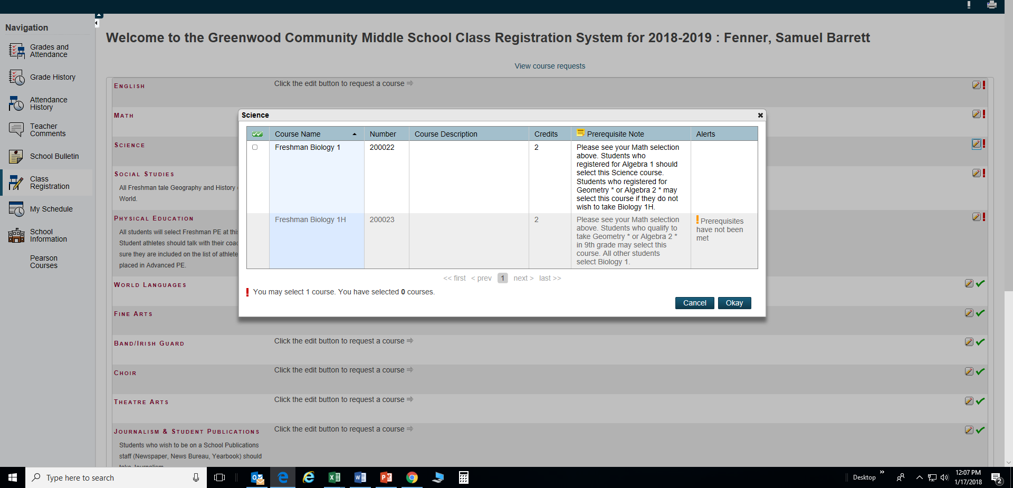

Slide 16
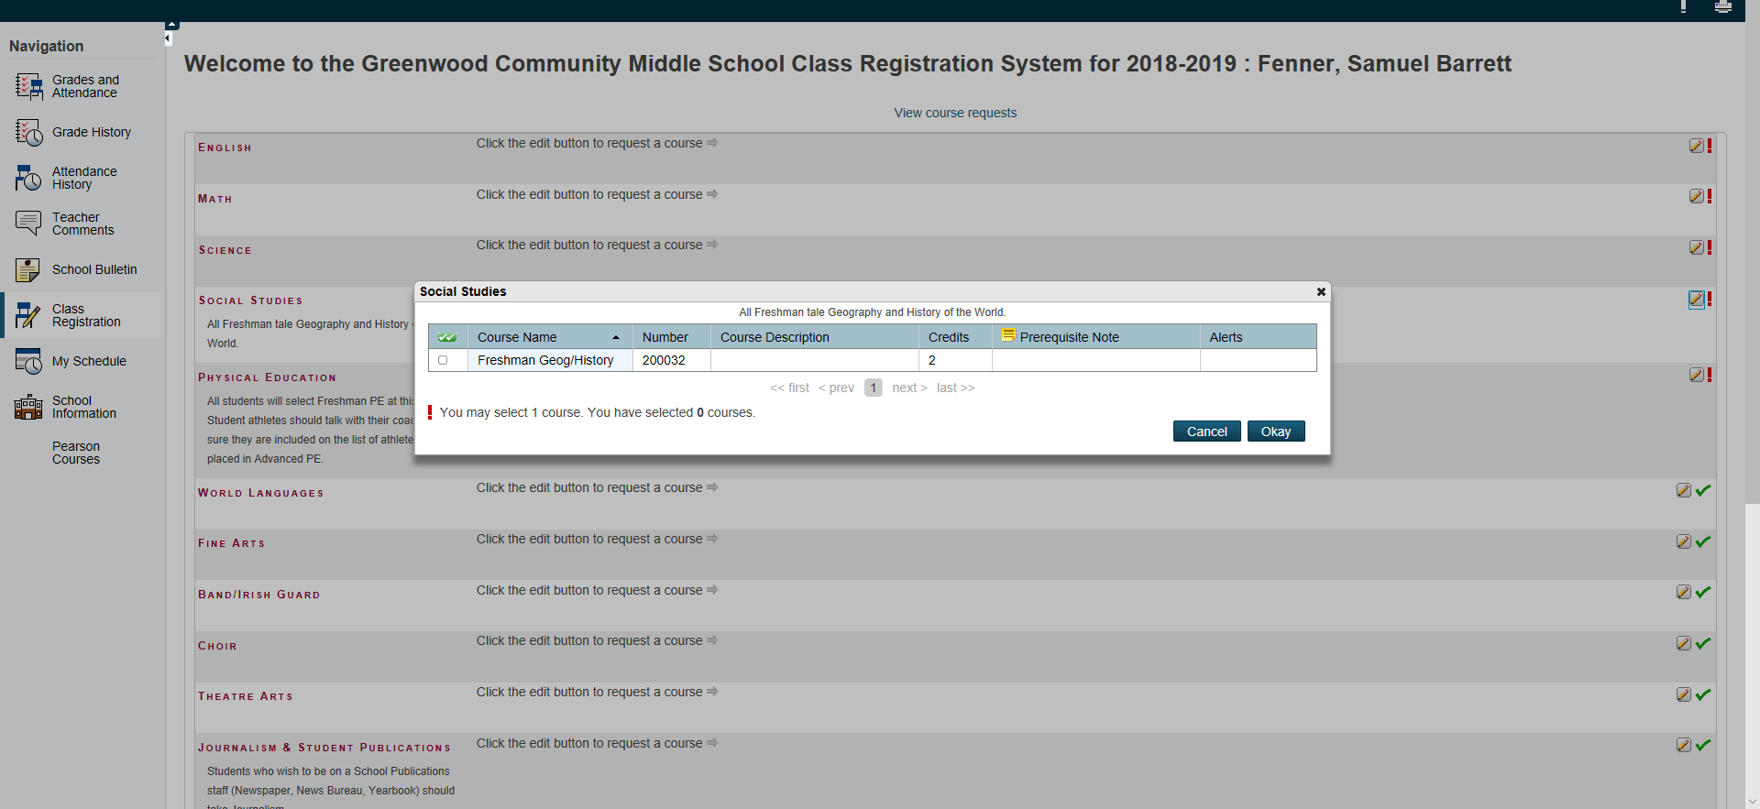

Slide 17
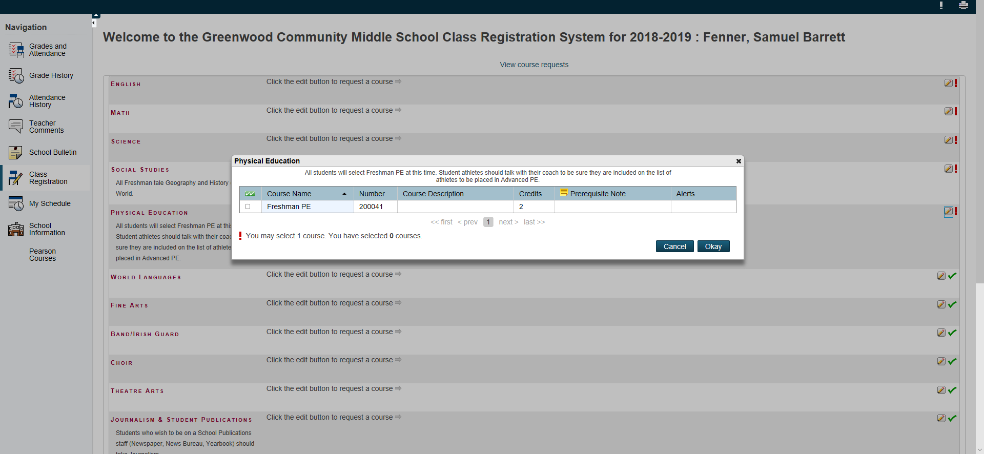

Slide 18
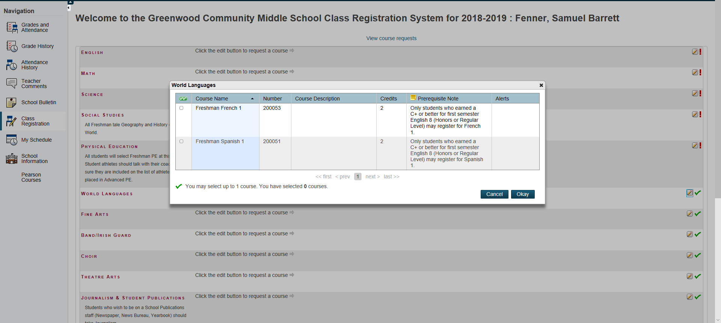

Slide 19
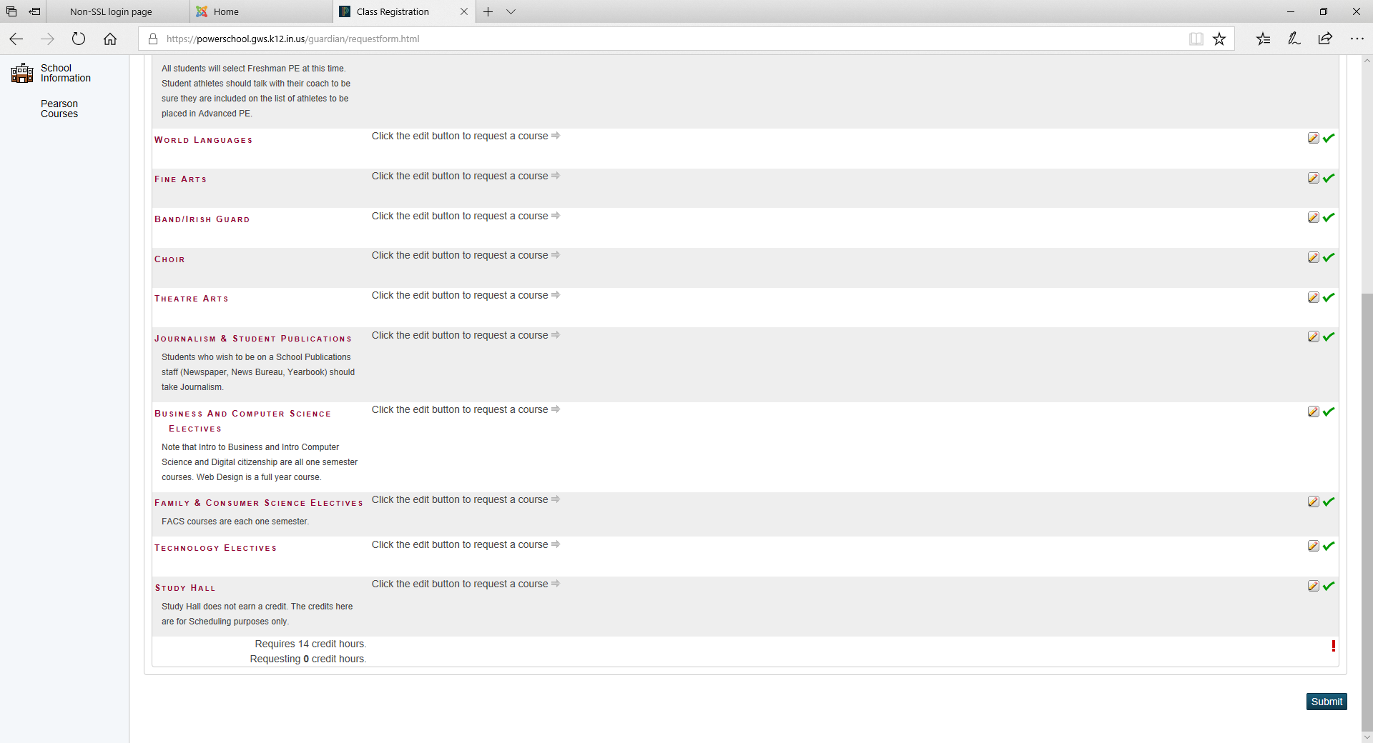

Slide 21
Freshmen Counselors
Counselors are assigned by the student’s last name
Mrs. Fenner
Last names: A-L
Ms. Wilson
Last names: M-Z

